Slide 1

A STUDY ON REAL-TIME DATA MONITORING AND ALERTING WITH ALTERYX
Guided by
Dr.Gnanadasan
Professor
SRM Institute of Science and Technology
Presented by
Janane K
EC2252001010013
MBA Business Analytics(2nd Year)
SRM Institute of Science and Technology

Slide 2
INTRODUCTION
In the dynamic landscape of today's data-driven world, the ability to harness and analyze real-time data has become paramount for organizations seeking to make informed and timely decisions. This study delves into the realm of real-time analytics, focusing on the integration of Alteryx and Tableau to create a robust framework for data monitoring and alerting.
Alteryx, a leading data analytics platform, offers a powerful suite of tools designed to streamline the end-to-end analytics process. From data preparation to advanced analytics and reporting, Alteryx empowers users to derive actionable insights from their data. One significant aspect of Alteryx's capabilities is its ability to handle real-time data, allowing organizations to monitor key metrics as they evolve.
The integration of Tableau, a renowned data visualization tool, amplifies the potential of Alteryx by providing a visually rich and interactive interface for data exploration. Through this integration, users can create dynamic dashboards and reports that offer real-time insights into their data. The seamless connection between Alteryx and Tableau creates a powerful synergy, enhancing the overall data analytics workflow.

Slide 3
This study explores the practical implementation of real-time data monitoring and alerting using Alteryx, with a specific focus on the integration with Tableau for visual analytics. The goal is to showcase how this combination of tools can be leveraged to build a comprehensive solution for monitoring, analyzing, and responding to real-time data changes.
The subsequent sections of this study will delve into the technical aspects of setting up the integration between Alteryx and Tableau, demonstrating how data flows seamlessly between the two platforms. Furthermore, practical use cases and examples will illustrate the effectiveness of this integrated approach in diverse scenarios.
As organizations increasingly recognize the value of real-time analytics, understanding the nuances of tools like Alteryx and Tableau in conjunction becomes essential for staying ahead in the competitive landscape. This study will present case studies and practical examples to highlight how the integrated approach facilitates rapid decision-making and provides a competitive edge in today's fast-paced business environment.

Slide 4
Supply Chain Dynamics: Navigating Complexity
In the intricate web of modern supply chains, the need for real-time insights is paramount. This study explores the intersection of supply chain dynamics and analytics, emphasizing the critical role of timely data in decision-making.

Slide 5
OBJECTIVES
To cleanse and manipulate data using Alteryx's features for consistency and accuracy.
To import cleaned data into Tableau for visualization.
To connect Tableau dashboard to Alteryx for real-time updates.
To utilize Alteryx to automate email alerts upon workflow refresh.
To monitor and optimize the integrated workflow for efficiency.
To document the process and create a user-friendly guide for replication.

Slide 6
WORK FLOW

Slide 7
Software Used
Tableau Desktop 2023.3
Alteryx Designer 2023.1.0.0

Slide 8
Methodology
Downloaded the supply chain dataset from Kaggle.
Ensured the dataset contained relevant information for supply chain analysis
Data Import and Cleaning in Alteryx:
Opened Alteryx and imported the Kaggle supply chain dataset.
Performed data cleaning tasks such as handling missing values, removing duplicates, and standardizing formats.
Explored and identified any outliers or anomalies in the data.
Data Visualization in Tableau:
Saved the cleaned dataset in Tableau Hyper format for efficient Tableau integration.
Opened Tableau and connected to the Hyper file.

Slide 9
Created separate visualizations for the identified KPIs:
Top 10 materials shipped
Geospatial Analysis
Supplier Performance
Transportation Distance
Vehicle Performance
Customer Preference
Dashboard Creation in Tableau:
Combined individual visualizations into a comprehensive dashboard.
Tableau Public Publishing:
Published the finalized dashboard to Tableau Public for online sharing.
Obtained the public link for the published dashboard.

Slide 10
Link Import in Alteryx:
In Alteryx, imported the Tableau Public link for the dashboard.
Used the link to access and integrate the Tableau dashboard within the Alteryx workflow.
SMTP Server Setup in Alteryx:
Configured a free SMTP server within Alteryx for sending email notifications.
Set up the necessary email parameters such as sender address, recipient address, subject, and message.
Email Notification Configuration:
Integrated email notification tools in Alteryx.
Configured the workflow to trigger email notifications upon each data refresh or update.

Slide 11
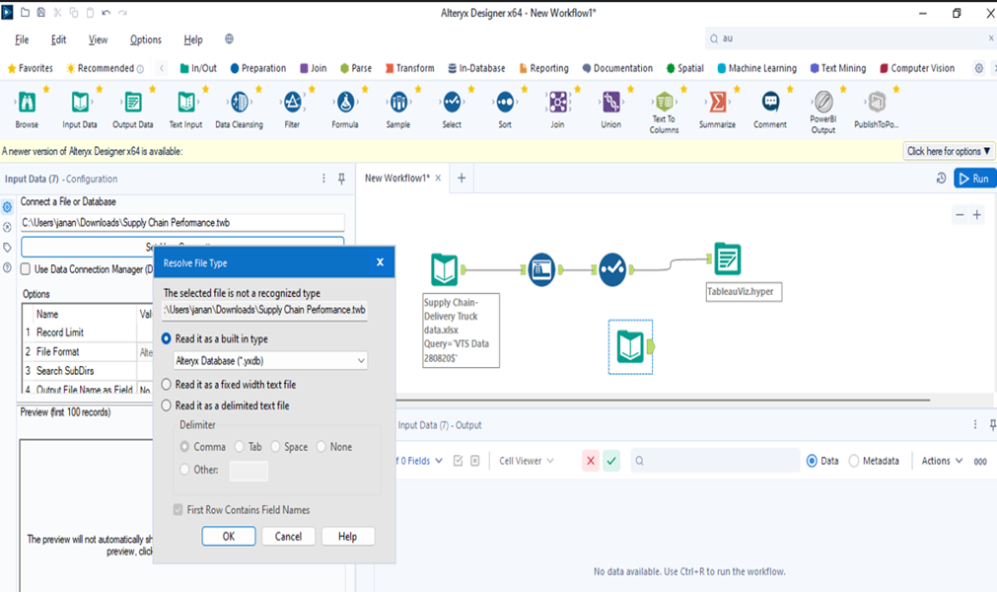
Data Interpretation and Analysis
Workflow of the process from importing the data until saving the cleaned up data as Tableau.hyper

Slide 12
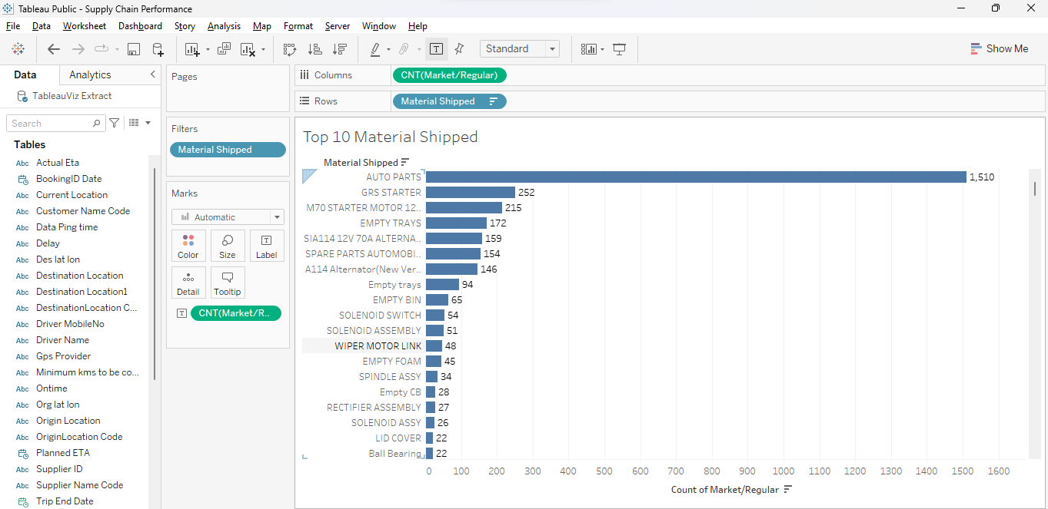
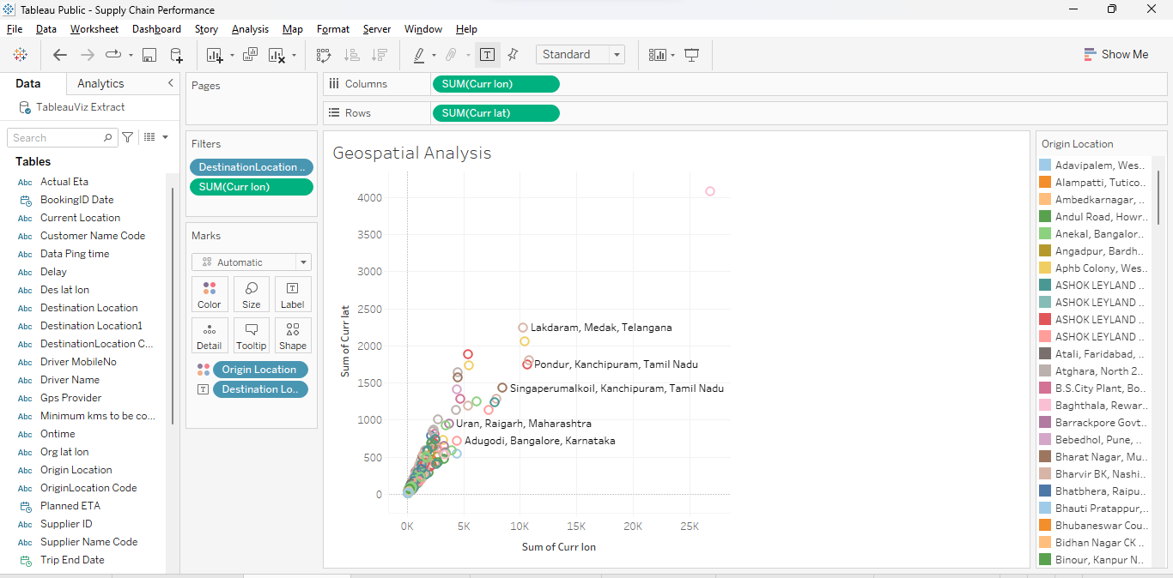
Top 10 Material Shipped
Geospatial Analysis

Slide 13
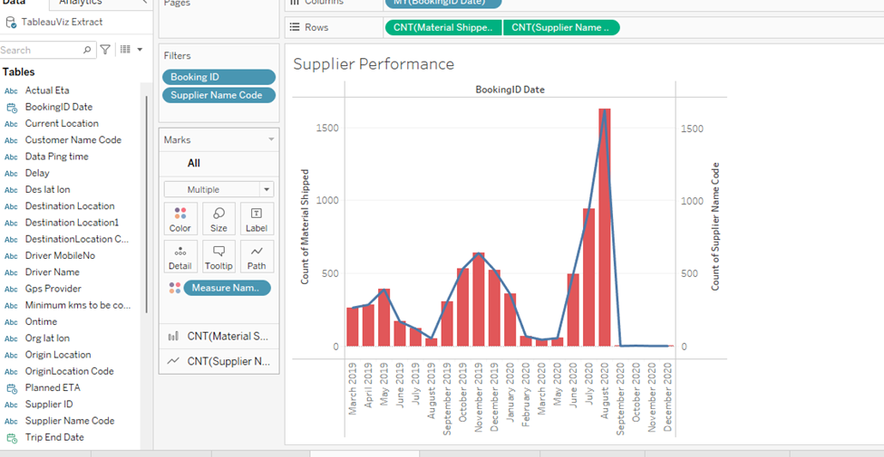
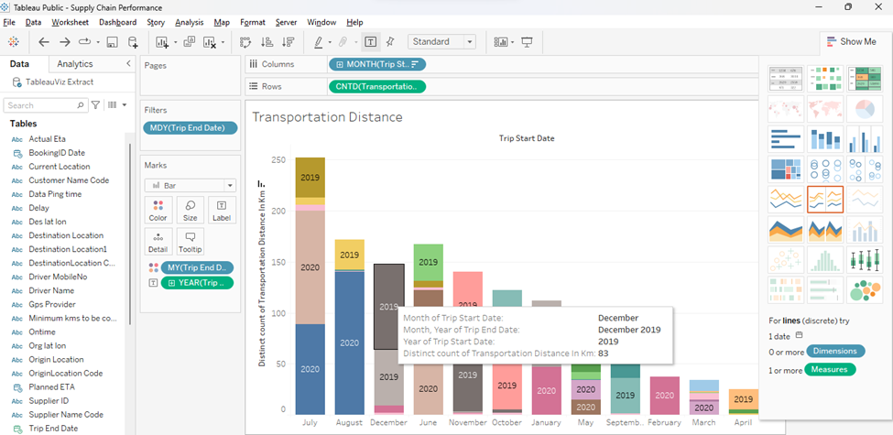
Supplier Performance over the Years
Transportation Distance

Slide 14
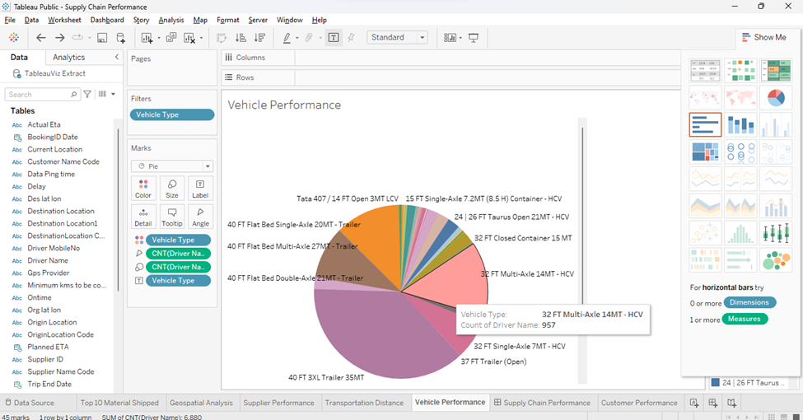
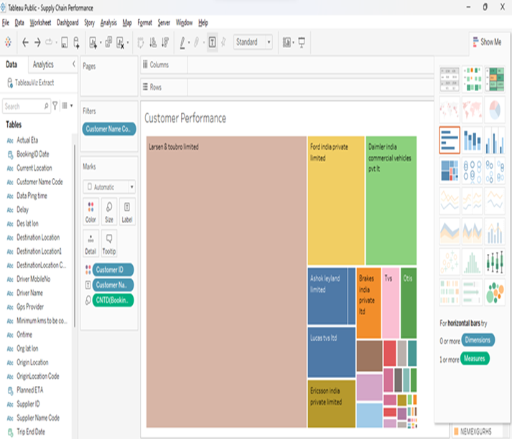
Vehicle Performance
Customer Performance

Slide 15
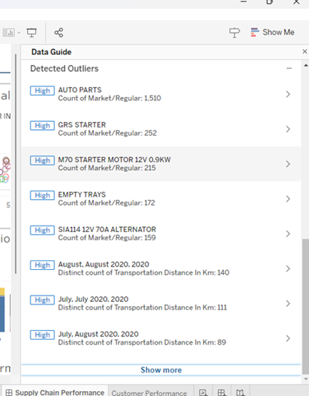
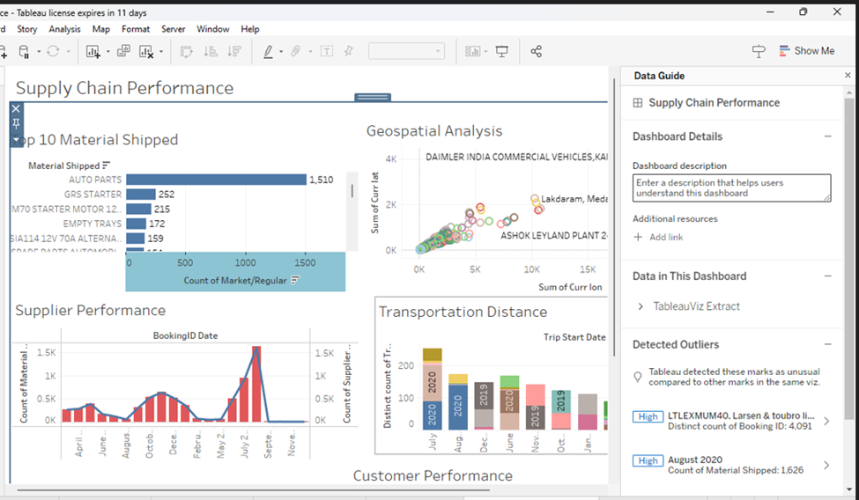
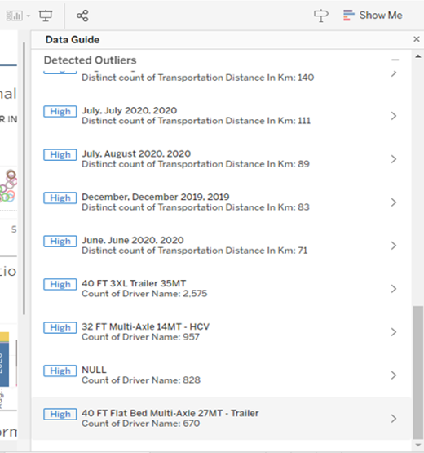
Supply Chain Performance Dashboard

Slide 16
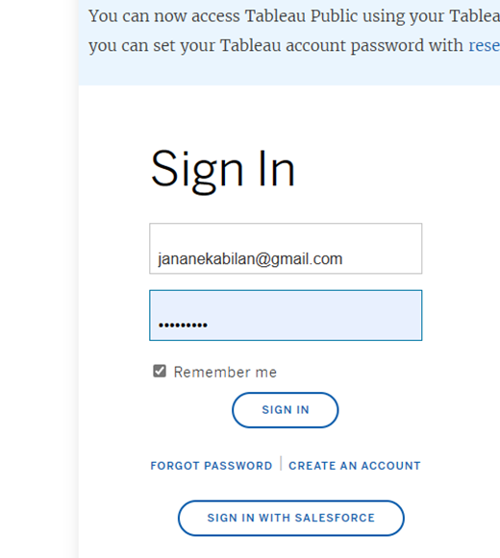
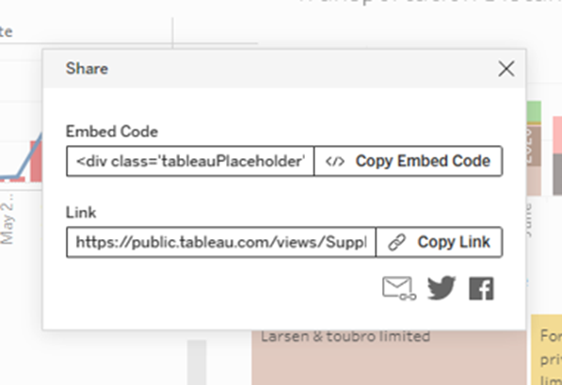
Dashboard posted in Tableau Public

Slide 17
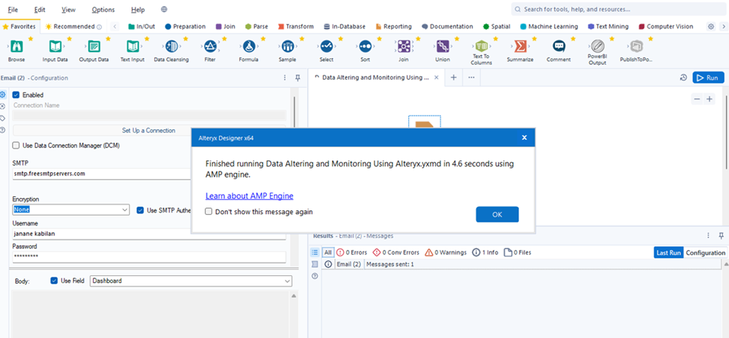
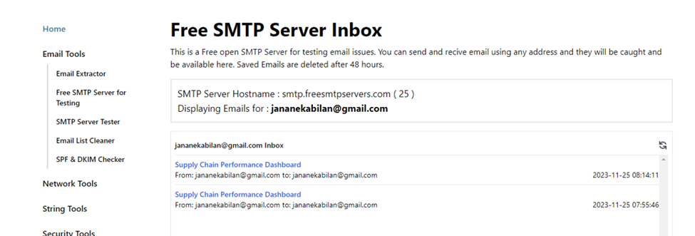
The embed link imported in Alteryx
Free SMTP Server is set up and mail alert is set

Slide 18
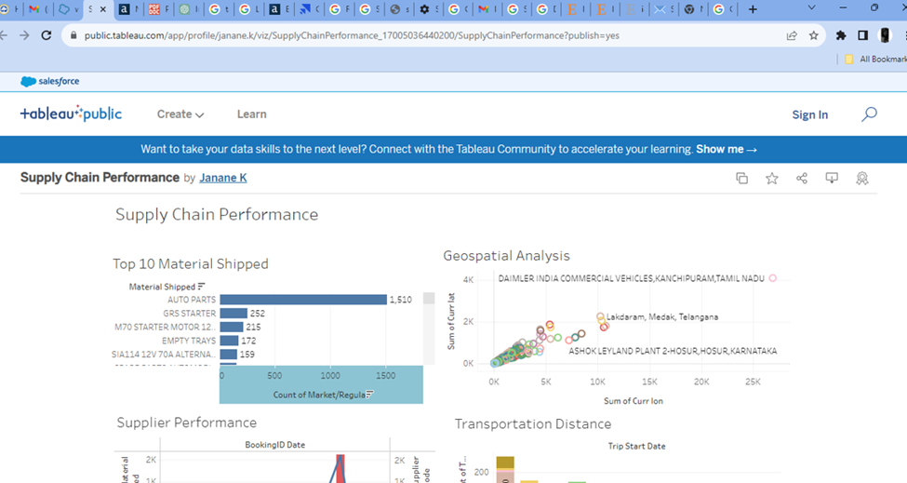
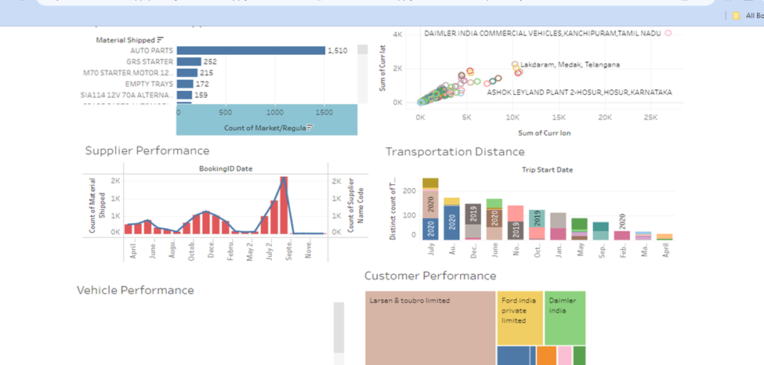
Mail alert is sent whenever the workflow gets updated

Slide 19
Findings and Conclusions
Top 10 Materials Shipped
Auto Parts
Auto parts secured the top position in the materials shipped, indicating a significant demand or movement of components within the supply chain.
GRS Starter
GRS Starter, occupying a prominent position, suggests a substantial shipping volume of starters for engines. This specific part might be crucial in the automotive or industrial sectors.
M70 Starter Motor 120 0.9kW
The M70 Starter Motor, specifying its power capacity, emerged as a key item in the shipped materials. This detailed specification provides clarity on the type and capability of the shipped starter motor.

Slide 20
Top 5 Geospatial Analysis
Salmora Tiniali, Lakhimpur, Assam - Zoo Road, Kamrup, Assam
These locations in Assam exhibit a consistent latitude (26) and longitude (91), suggesting a concentrated geographical area in the state.
Sumerpur Krishi Upaj Mandi, Pali, Rajasthan - Yaarlipura, Jaipur, Rajasthan
The Rajasthan locations demonstrate a specific pattern with latitude values (52, 26) and longitude values (150, 75), indicating a clear geographic relationship.
WABCO INDIA LTD-AMBATTUR, CHENNAI, TAMIL NADU - WABCO INDIA LTD, HOSUR, TAMIL NADU
The locations in Tamil Nadu (Chennai and Hosur) exhibit latitude (38, 89) and longitude (239, 556) values, reflecting a distinct spatial distribution in the southern part of India.

Slide 21
Supplier Performance
The count of supplier performance in August 2020 surpasses that of 2019, indicating an improvement or increased activity in supplier performance during this period. This positive trend may be attributed to various factors such as enhanced supplier relationships, improved delivery timelines, or increased product quality.
Transportation Analysis
The transportation distance analysis reveals that the shortest distance occurred on August 8th, 2020, and concluded on August 13th, 2020. In contrast, the longest transportation distance was observed on July 11th, 2020, concluding on July 23rd, 2020. These insights into the variability of transportation distances across different time periods can be valuable for optimizing logistics and planning.
Vehicle Performance
The analysis of vehicle performance indicates a notable preference among drivers for the 40 FT 3XL Trailer with a capacity of 35 metric tons. On the other hand, the least preferred vehicle is the 1.5 MT Pick-Up with an open body. This distinction in driver preferences highlights the significance of selecting suitable vehicles based on their capacity and design.
Customer Performance
Larson and Turbo Limited, Ford India Private Limited and Daimler India Commercial Vehicles Pvt Ltd made the highest booking orders

Slide 22
Suggestions
Selective Data Masking:
Implement selective data masking techniques to protect sensitive information while allowing for analysis. This ensures that critical details are safeguarded, minimizing the risk of unauthorized access.

Slide 23
Conclusion
In conclusion, the study successfully detailed the process of collecting, cleaning, visualizing, and disseminating supply chain data using Kaggle, Alteryx, Tableau, and email notifications. By employing Alteryx for data import and cleaning, Tableau for visualization and dashboard creation, and a free SMTP server for email notifications, a streamlined workflow was established. The creation of individual visualizations for key performance indicators (KPIs) such as top materials shipped, geospatial analysis, supplier performance, transportation distance, vehicle performance, and customer preferences provided a comprehensive understanding of the supply chain dynamics.

Slide 24
The utilization of Tableau Public facilitated the sharing of the final dashboard, making it accessible to a wider audience. The integration of the Tableau Public link back into Alteryx allowed for seamless inclusion in the workflow. Furthermore, the implementation of automated email notifications added a layer of proactive communication, ensuring stakeholders were informed promptly upon each data refresh.
Thorough testing, documentation, and ongoing monitoring were crucial components of this methodology, contributing to the reliability and sustainability of the entire process. By documenting the steps taken and providing clear instructions, future maintenance and updates can be executed with ease.
Ultimately, this integrated approach not only enhanced the efficiency of supply chain data management but also empowered stakeholders with visually compelling insights, fostering informed decision-making. The combination of powerful data tools and thoughtful methodology serves as a model for organizations seeking to optimize their supply chain processes through data-driven strategies.

Slide 25
References
https://publications.aaahq.org/jeta/article/19/1/165/154
https://link.springer.com/article/10.1023/A:1013882326814
https://www.jstor.org/stable/44084125
https://books.google.com/books?hl=en&lr=&id=MvNFDwAAQBAJ&oi=fnd&pg=PP1&dq=Alteryx+&ots=NDq7pfCrTa&sig=youslj6Dq88XpmGqLAKy5Gnlun0
https://meridian.allenpress.com/aisej/article/16/1/60/494539
https://ieeexplore.ieee.org/abstract/document/10192692/

Slide 26
THANK YOU

